Slide 1
Evaluating Classifiers

Slide 2
Agenda
Introduction
Evaluation Strategies
Re-substitution
Leave one out
Hold out
Cross Validation
Bootstrap Sampling
Classifiers Evaluation Metrics
Binary classification confusion matrix
Sensitivity and specificity
ROC curve
Precision & Recall
Multiclass classification

Slide 3
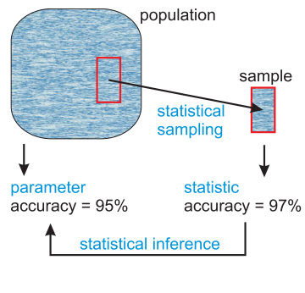
Introduction
Evaluation aims at selecting the most appropriate learning schema for a specific problem
We evaluate its ability to generalize what it has been learned from the training set on the new unseen instances

Slide 4
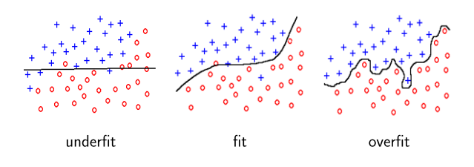
Evaluation Strategies
Different strategies to split the dataset into training ,testing and validation sets.
Error on the training data is not a good indicator of performance on future data, Why?
Because new data will probably not be exactly the same as the training data!
The classifier might be fitting the training data too precisely (called Over-fitting)

Slide 5
Re-substitution
Testing the model using the dataset used in training it
Re-substitution error rate indicates only how good /bad are our results on the TRAINING data; expresses some knowledge about the algorithm used.
The error on the training data is NOT a good indicator of performance on future data since it does not measure any not yet seen data.

Slide 6
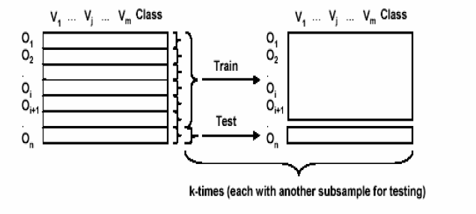
Leave one out
leave one instance out and train the data using all the other instances
Repeat that for all instances
compute the mean error

Slide 7
Hold out
The dataset into two subsets use one of the training and the other for validation (In Large datasets)
Common practice is to train the classifiers using 2 thirds of the dataset and test it using the unseen third.
Repeated holdout method: process repeated several times with different subsamples
error rates on the different iterations are averaged to give an overall error rate

Slide 8
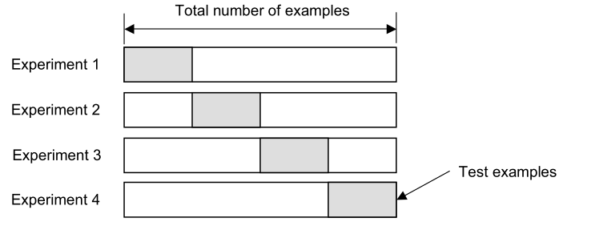
K-Fold Cross Validation
Divide the data to k equal parts (folds),
One fold is used for testing while the others are used in training,
The process is repeated for all the folds and the accuracy is averaged.
10 folds are most commonly used
Even better, repeated
Cross-validation

Slide 9
Bootstrap sampling
CV uses sampling without replacement
The same instance, once selected, can not be selected again for a particular training/test set
The bootstrap uses sampling with replacement to form the training set
Sample a dataset of n instances n times with replacement to form a new dataset of n instances
Use this data as the training set
Use the instances from the original dataset that don’t occur in the new training set for testing

Slide 10
Are Train/Test sets enough?
Results Known
+
Training set
+
-
-
Data
+
Model Builder
Evaluate
Predictions
+
-
+
-
Y
N
Testing set

Slide 11
Train, Validation, Test split
Results Known
+
Model
Builder
+
Training set
-
-
Data
+
Evaluate
Model Builder
Predictions
+
-
+
-
Y
N
Validation set
+
-
+
-
Final Evaluation
Final Test Set
Final Model

Slide 12
Evaluation Metrics
Accuracy:
It assumes equal cost for all classes
Misleading in unbalanced datasets
It doesn’t differentiate between different types of errors
Ex 1:
Cancer Dataset: 10000 instances, 9990 are normal, 10 are ill , If our model classified all instances as normal accuracy will be 99.9 %
Medical diagnosis: 95 % healthy, 5% disease.
e-Commerce: 99 % do not buy, 1 % buy.
Security: 99.999 % of citizens are not terrorists.

Slide 13
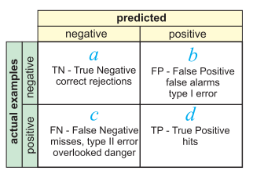
Binary classification Confusion Matrix

Slide 14



Binary classification Confusion Matrix
True Positive Rate
False Positive Rate
Overall success rate (Accuracy)
Error rate =1- success rate

Slide 15


Sensitivity & Specificity
Sensitivity
Measures the classifier ability to detect positive classes (its positivity)
Specificity
The specificity measures how accurate is the classifier in not detecting too many false positives (it measures its negativity)
high specificity are used to confirm the results of sensitive
Notes:
A very sensitive classifier will find a number of false positives, but no true positives will be missed , the calculated number measures the classifier ability to detect positive classes (its positivity)
The maximum value for sensitivity is 1 (very sensitive classifier) and the minimum is 0 (the classifier never predicts positive values)
--
The specificity measures how accurate is the classifier in not detecting too many false positives, it is calculated by finding the percentage of true negatives from all negative instances (it measures its negativity)
The maximum value for Specificity is 1 (very specific ,no false positives) and the minimum is 0 ( means that it classifies everything is positive )
high specificity are used to confirm the results of sensitive

Slide 16
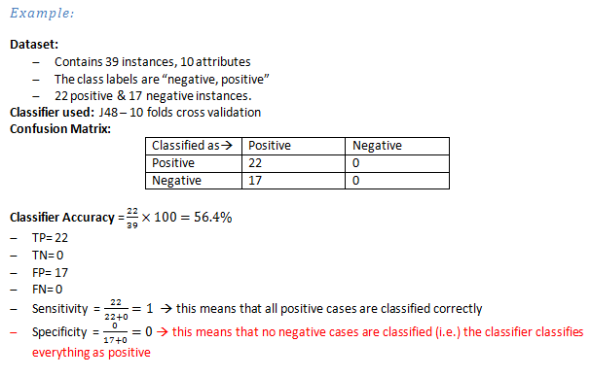

Slide 17
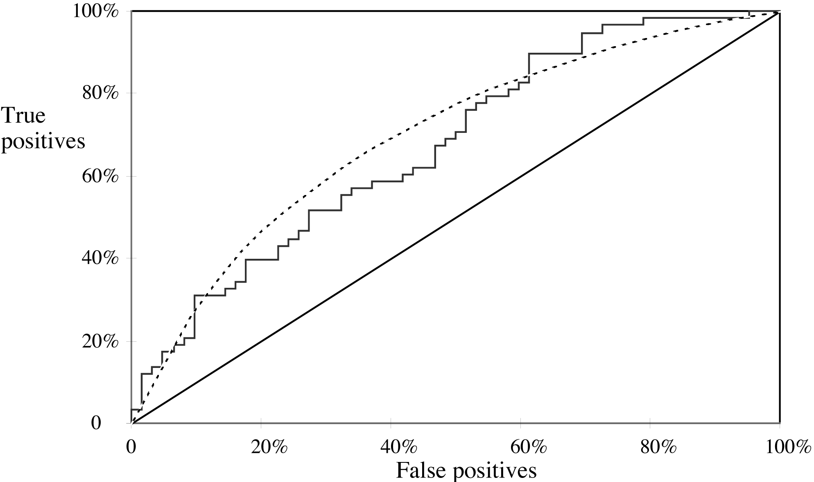
ROC Curves
Stands for “receiver operating characteristic”
Used in signal detection to show tradeoff between hit rate and false alarm rate over noisy channel
Jagged curve—one set of test data
Smooth curve—use cross-validation
Notes:
y axis shows percentage of true positives in sample
x axis shows percentage of false positives in sample

Slide 18
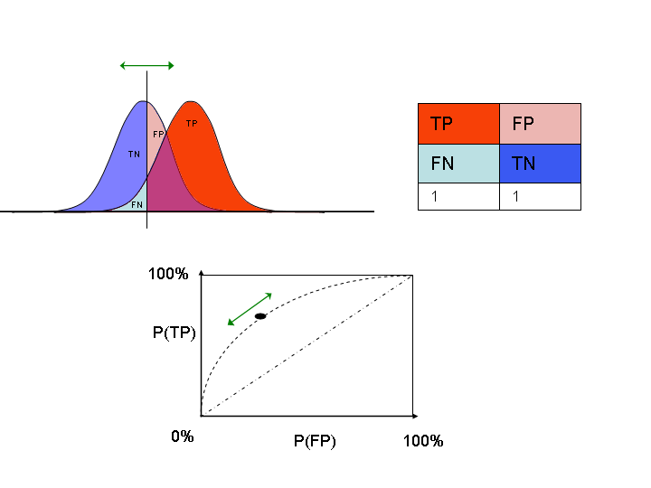
moving threshold
class 0 (negatives)
class 1 (positives)
Identify a threshold in
your classifier that you
can shift.
Plot ROC curve while you
shift that parameter.

Slide 19
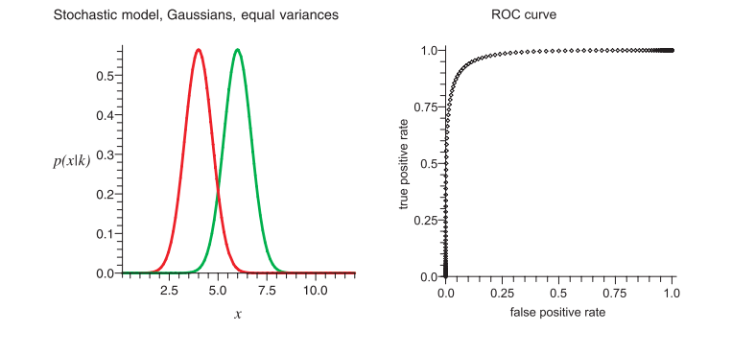

Slide 20
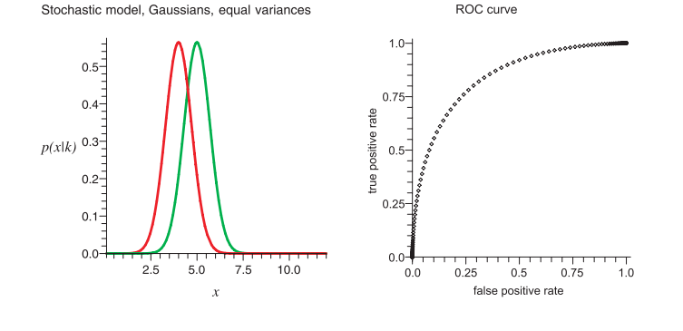

Slide 21
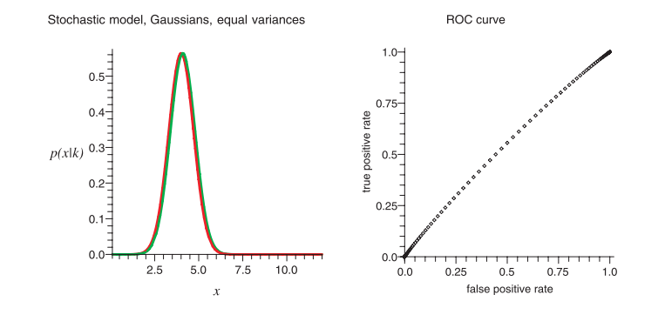

Slide 22
ROC curve (Cnt’d)
Accuracy is measured by the area under the ROC curve. (AUC) An area of 1 represents a perfect test; an area of .5 represents a worthless test:
.90-1 = excellent
.80-.90 = good
.70-.80 = fair
.60-.70 = poor
.50-.60 = fail

Slide 23
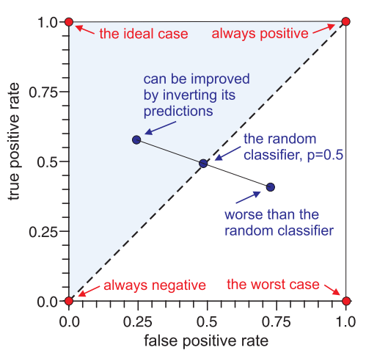
ROC curve characteristics

Slide 24
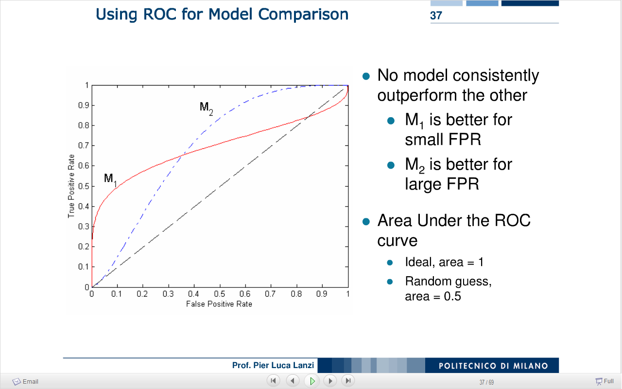
ROC curve (Cnt’d)
For example, M₁ is more conservative (more specific and less sensitive)
Where M₂ is more liberal (more sensitive and less specific
For a small focused dataset M₁ is better,
For large dataset M₂ might be a better model,
After all this depends on the application we are applying these models in.
Notes:
For a small, focused sample, use method M1
For a larger one, use method M2
In between, choose between M1 and M2 with appropriate probabilities
For example, M₁ is more conservative (more specific and less sensitive) meaning that it tends to classify few false positives and more false negatives
Where M₂ is more liberal (more sensitive and less specific) meaning that it tends to classify many false positives with few false negatives (it tends to classify everything as positive)
Finally, for a small focused dataset M₁ is better to be selected, and for large dataset M₂ might be a better model, but after all this depends on the application we are applying these models in.

Slide 25


Recall & Precision
It is used by information retrieval researches to measure accuracy of a search engine, they define the recall as (number of relevant documents retrieved) divided by ( total number of relevant documents)
Recall
Precision

Slide 26
F-measure
The F-measure is the harmonic-mean (average of rates) of precision and recall and takes account of both measures.
It is biased towards all cases except the true negatives

Slide 27
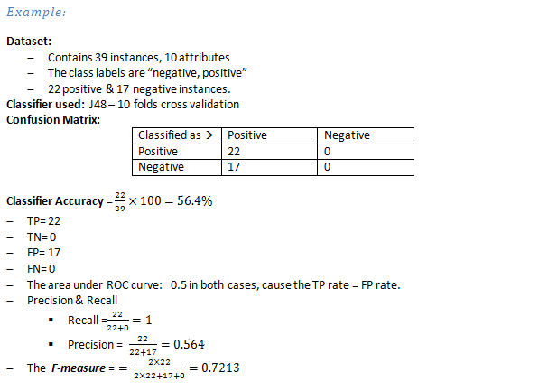

Slide 28
Notes on Metrics
As we can see the True Positive rate = Recall = Sensitivity all are measuring how good the classifier is in finding true positives.
When FP rate increases, specificity & precision decreases & vice verse,
It doesn't mean that specificity and precision are correlated,
for example in unbalanced datasets the precision can be very low where the specificity is high
cause the number of instances in the negative class is much higher than the number of positive instances

Slide 29
Multiclass classification
For Multiclass prediction task, the result is usually displayed in confusion matrix where there is a row and a column for each class,
Each matrix element shows the number of test instances for which the actual class is the row and the predicted class is the column
Good results correspond to large numbers down the diagonal and small values (ideally zero) in the rest of the matrix
Classified as → | a | b | c
A | TP_{aa} | FN_{ab} | FN_{ac}
B | FP_{ab} | TN_{bb} | FN_{bc}
C | FP_{ac} | FN_{cb} | TN_{cc}

Slide 30
Multiclass classification (Cont’d)
For example in three classes task {a , b , c} with the confusion matrix below, if we selected a to be the class of interest then
Note that we don’t care about the values (FNcb & FNbc) as we are considered with evaluating how the classifier is performing with class a, so the misclassifications between the other classes is out of our interest.

Slide 31
Multiclass classification (Cont’d)
To calculate overall model performance, we take their weighted average to evaluate the overall performance of the classifier.
Averaged per category (macro average) :
Gives equal weight to each class, including rare ones

Slide 32


Multiclass classification (Cont’d)
Micro Average:
Obtained from true positives (TP), false positives (FP), and false negatives (FN) for each class, and F-measure is the harmonic mean of micro-averaged precision and recall
Micro average gives equal weight to each sample regardless of its class.
They are dominated by those classes with the large number of samples.

Slide 33
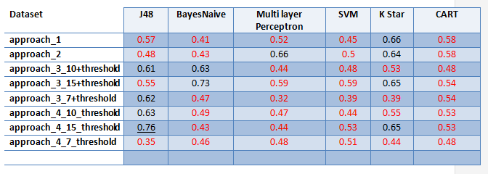

Example: Area under ROC

Slide 34
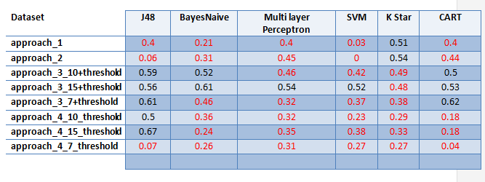
Example: F-Measure

Slide 35
Thank you :-)

